Slide 1

Programming in c
C Language Features…
Suited for both system software and application software's
(provides the capabilities of assembly language with the
features of high level language)
Efficient & Faster code
(compared to other high level languages like BASIC,FORTRON)
Portable (supports variety of HW and OS platforms)
Structured Programming (function oriented)
C standards…
Traditional C, K & R C ,
ANSI C,
ANSI/ISO C 89 ,
C99

Slide 2
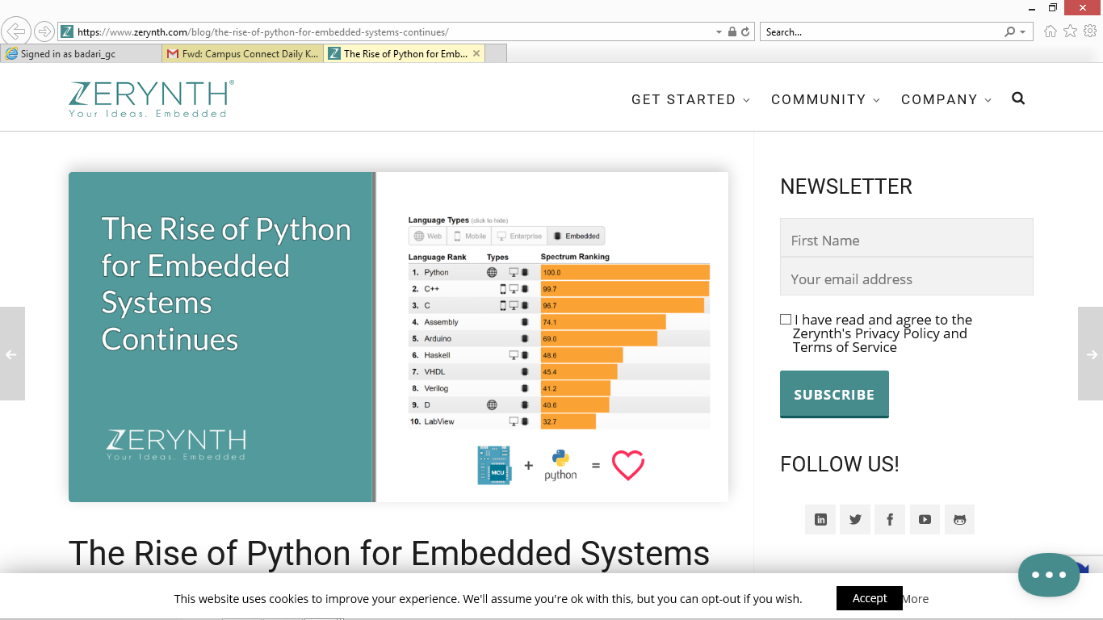
Programming in c
Importance of C ... Even Today ranks among the top

Slide 3
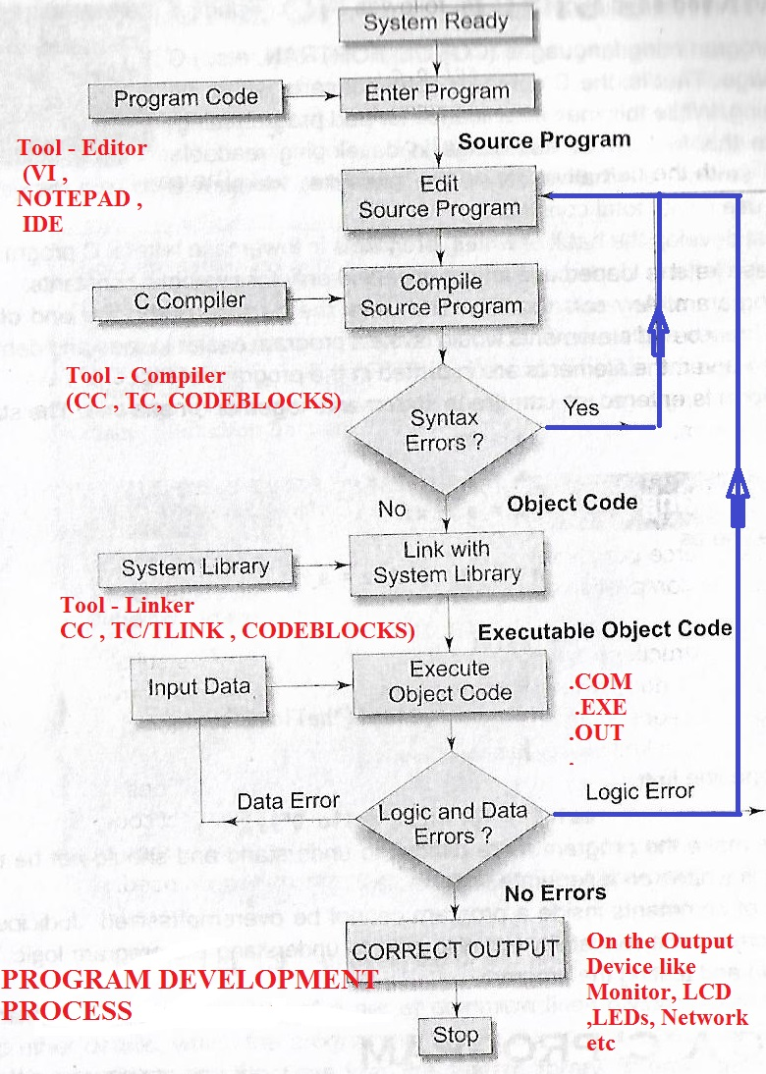
Programming in c
Program Development Stages

Slide 4
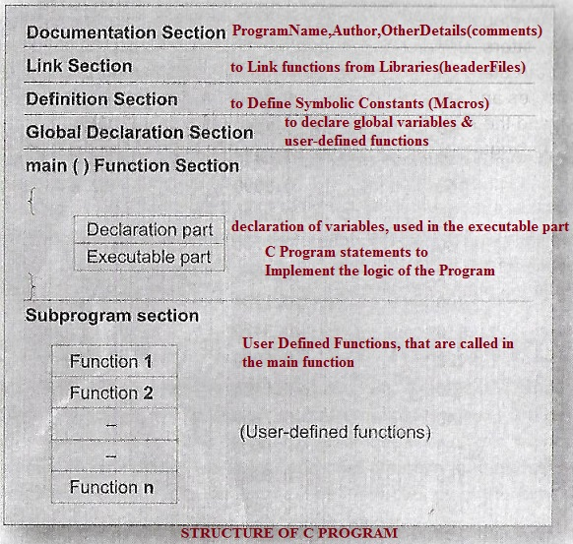
Programming in c
Structure of C Program

Slide 5
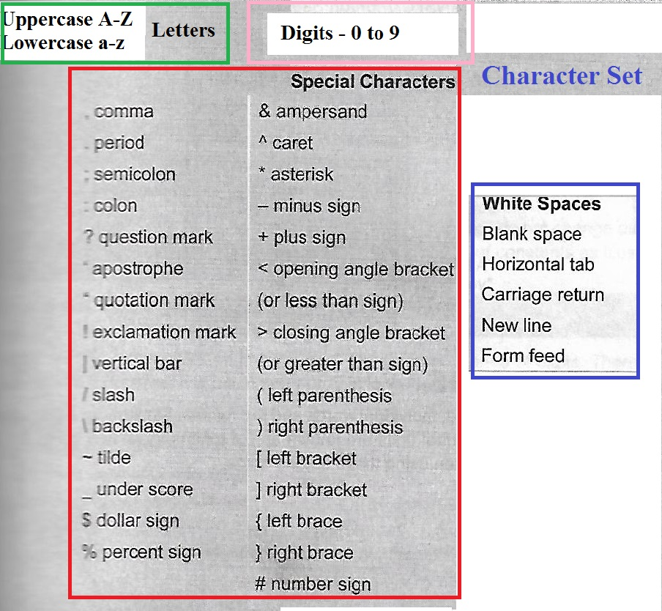
Programming in c
A Program is prepared by writing set of instructions, to process the data and produce some meaningful output. The Program instructions are formed using certain symbols and words according to some rigid rules known as syntax rules/grammar.
C Language Character Set
The characters that can be used to form words,numbers and expressions

Slide 6
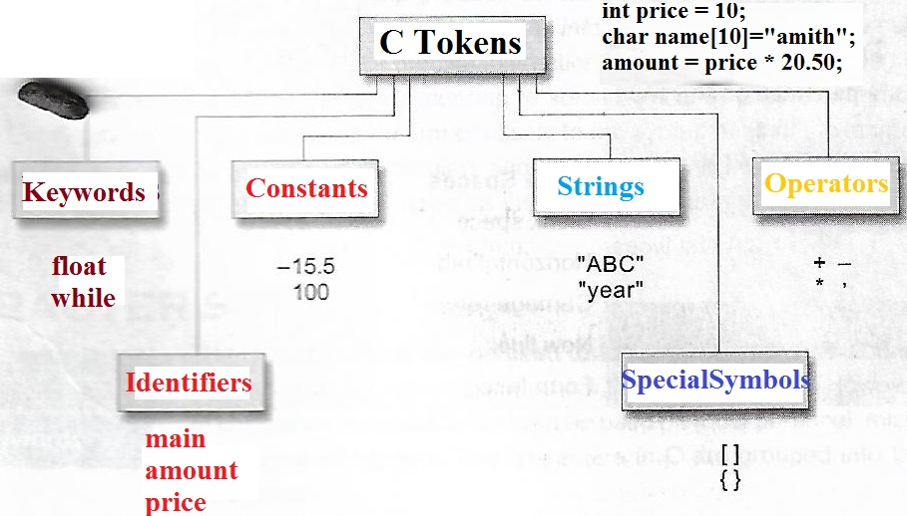
Programming in c
C Tokens – the smallest individual units are known as tokens.
C Language Tokens
Programs are written using these tokens and the syntax of the language

Slide 7
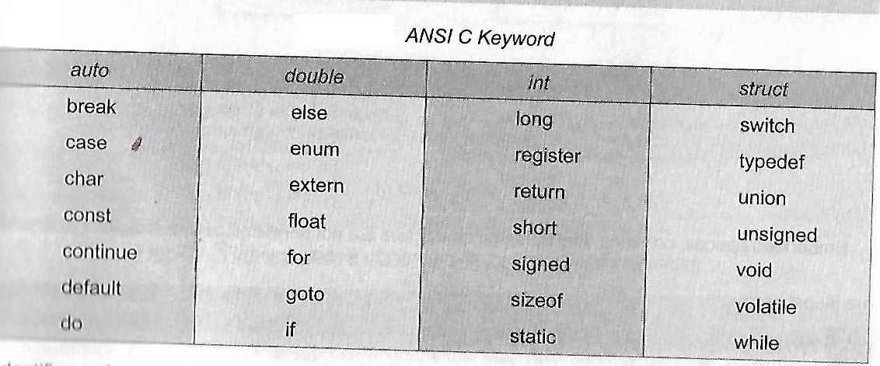
Programming in c
C Keywords– Every C word is classified as either keyword or an identifier. All keywords has predefined meaning as per ANSI C, written in lower case
C Language Keywords
Keywords serve as basic building blocks for program statements

Slide 8
Programming in c
C Identifiers– refers to the names of variables, functions and arrays. They are user defined, case sensitive (one can use both upper case/lowercase)
Rules for Identifiers
First character must be an alphabet ( or underscore).
Must consist of only letters, digits or underscore
Only first 31 characters are significant.
Cannot use a keyword.
Must not contain whit space
C Language Identifiers
int simple_interest , _price , DesignCount , val89_per90;
float sevenSegTable[10] ;
void cal_avgMarks ( );
Underscore character is used as a link between two words in long identifiers

Slide 9
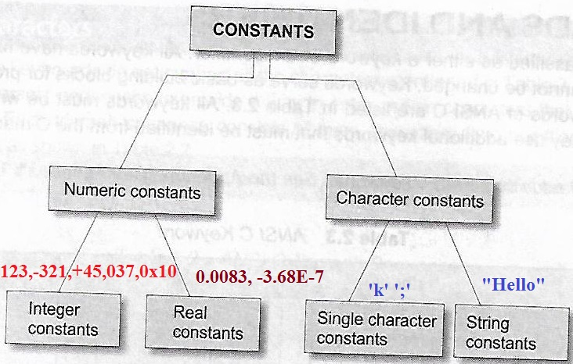
Programming in c
C Constants– fixed values that do not change during the execution of a program
Spaces,commas and non-digit characters are not permitted between digits
C Language Constants
Integer Constants –
sequence of digits, can be represented as:
Decimal integer ( combination of 0 to 9 with optional + or – sign)
Octal integer (combination of 0 to 7 with leading 0, with optional + or – sign)
Hexadecimal integer (0-9,a - f or A – F, with leading/preceded by 0x or 0X)
Qualifiers – U,L and UL or u,l and ul are appended to constants to increase the range of storgae. Ex: 5678L
Real Constants – to represent very small/large quantities we use real /floating point nos.
Decimal notation – 215. , .95 , -.07
Exponential / Scientific notation – 2.15e2 ( e2 means multiply by 10 power 2)

Slide 10
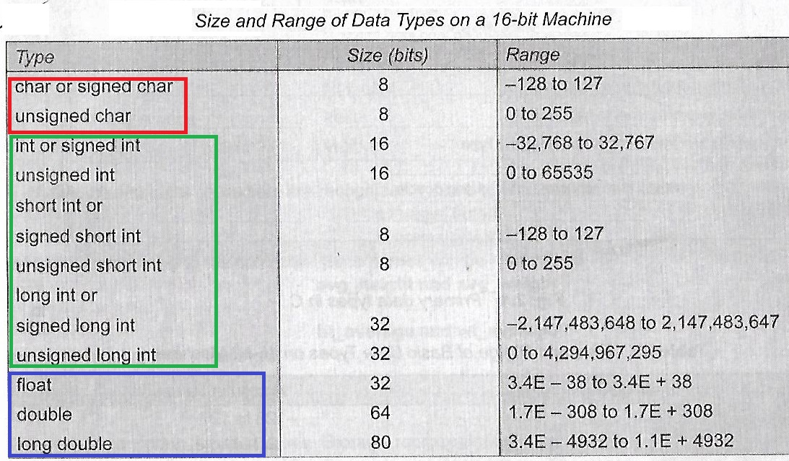
Programming in c
C Variables – is a named location in a memory where a program can manipulate the data. This location is used to hold the value of the variable. It may take different values at different times during execution.
Data types – C variable belongs to any one of the specified data types.
C supports 3 data types:
Primary or fundamental data type [char, int, float, double,void]
Derived data types [ arrays, functions, structures,pointers]
User-defined data types [ typedef , enum]
C Language variables/types
Programs are written using these tokens and the syntax of the language

Slide 11
Programming in c
C Operator– is a symbol to perform mathematical or logical manipulations. Operators are used in programs to manipulate data and variables and forms part of mathematical or logical expressions.
Classification of C operators
Arithmetic Operators [ + - * / % ]
Relational Operators [ < > <= >= == != ]
Logical Operators [ || && ! ]
Bitwise Operators [ & | ^ ~ << >> ]
Assignment Operators [ = , short hand assignment : vop=exp; ]
Increment & Decrement Operators [ ++ - - ]
Conditional Operator [ exp1 ? exp2 : exp3 ]
Special Operators [ Comma operator : value = (x=10,y=5,x+y) ;
sizeof( ) operator ]
C Language Operators

Slide 12
Programming in c
Arithmetic Operators :
+ Addition (binary operator) or Unary Plus
- Subtraction (binary operator) or Unary minus
* Multiplication (binary operator)
/ Division (binary operator)
% Modulo Division (binary operator, for integers only)
Examples :
int a=5,b= -3, c=7,ans=0;
ans = a + b –c ; // ans = ?
ans = (a * c) / (a % c) ; // ans = ?
ans = c / a;// ans = ?
ans = c % a;// ans = ?
Arithmetic Operators
Integer Arithmetic : When all the operands in the expression are integers, the expression is call integer arithmetic, always results in integer value only. (i.e decimal value is truncated automatically).
If a = 5, b = 3, then a/b gives 1 (quotient), a % b gives 2 (remainder)
Sign Of the Result – If both operands are of same sign, the result is truncated towards zero. If one of them is –ve, the direction of truncation implementation dependant)

Slide 13
Programming in c
Relational Operators are
binary Operators, require two operands to operate
used to build relational Expressions.
always results in True ( Non-Zero) or False (Zero)
< Less Than > Greater Than
<= Less Than or Equal To >= Greater Than or Equal To
== Equal To != Not Equal To
Format: Arith.Exp1 Rel.Op Arith.Exp2
Relational Operators
Examples :
Assume A =45,b= 30
( A < B ) - False (A <= B) - False
( A > B) - True (A >= B) - True
( A == B) - False (A != B) - True
(A+B < A – B) - False (A – B < A+B) – True
(A+B+25 > =100 ) - True
Arithmetic Operators have higher precedence compare to Relational Operators
Relational operators are complement to one another:
> Is compliment of <=
!(x<y) can be written in simplified way as x>y

Slide 14
Programming in c
Logical Operators are
Used to combine two or more relational expressions to build logical expression or a compound relational expression
Always results in True ( Non-Zero) or False (Zero)
&& Logical AND
|| Logical OR
! Logical Not
Format:
Rel.Exp1 Log.Op Rel.Exp2 Log.Op Rel.Exp3
Truth Table:
Op1 Op2 Op1 && Op2 Op1 || Op2 !Op1
F F F T F T Means 1 or Non-Zero, F - Zero
F T F T T
T F F T F
T T T T F
Logical Operators
Ex: Assume P=92,
if ( (P > = 90) && (P <=100) )
printf(“S”); Result - S
Ex: P= 35,C=90,M=70
If( P<40 || C<40 || M < 40)
printf(“Fail”); Result - Fail
Relative Precedence of Relational and
Logical Operators :
Highest--- !
> >= < <=
== !=
&&
|| ---Lowest

Slide 15
Programming in c
Assignment Operators are
Having Lvalue as Left operand , Right operand is an expression
= Assignment Operator
Var Op = Exp → Shorthand Assignment Op.
( Meaning: Var = Var Op Exp ) , Op is a binary arithmetic operator
a = a + 1 ; -> a += 1;
a = a * (n + 1); -> a *= n+1
a = a % b ; -> a %= b;
Value[5 * j – 2] = value[ 5 * j – 2] + delta
Can be written as
Value[5 * j – 2] += delta;
Assignment Operators
Advantages:
1. Need not repeat the Lvalue
2. Statement more concise and easier to read
3. Statement is more efficient

Slide 16
Programming in c
Increment & Decrement Operators are
Are unary operators , require variable as the operand
Used as postfix or prefix to the variable
++ Increment Operator
- - Decrement Operator
a++ is used postfix operator - - a used as prefix
- - a is used as prefix operator a- - use as prefix
Increment & Decrement Operators
The increment and decrement operators can be used in complex statements.
Ex - m = n ++ - J + 10;
Working Method in Expressions:
1. When used as postfix, the expression is evaluated using the original value of the variable then the variable is incremented/decremented
2. When used as prefix, the variable is incremented/decremented first and then used in the expression

Slide 17
Programming in c
Conditional Operator is
Also referred as ternary operator uses the pair of ? And : to construct conditional expressions
exp1 ? exp2 : exp3
- exp1 is evaluated first,
if it is true/non-zero, exp2 is evaluated and becomes the value of the expression.
If exp1 is false, exp3 is evaluated and its value is returned as value of the expression
Ex: a = 10, b=15;
x = (a>b) ? a : b;
Conditional Operators

Slide 18
Programming in c
Bitwise Operators are
Used to operate on the data stored in memory at bit level,
Very used in hardware/embedded programming, where 1 or few bits are used to represent sensor data, to save memory.
Increases the performance of some programs/algorithms, when we operate at bit level
Not used with float or double or long double
& - bitwise AND | - bit OR ^ - bit XOR
~ - Compliment << Left Shift >> RightShift
Bitwise Operators
Examples :
int a = 35 , b = 29 , ans = 0;
Ans = a & b ; ans -
Ans = a | b ; ans –
Ans = a ^ b ; ans –
Ans = ~a ; ans –
Ans = a << 2 ; ans -
Ans = a >> 2 ; ans-

Slide 19
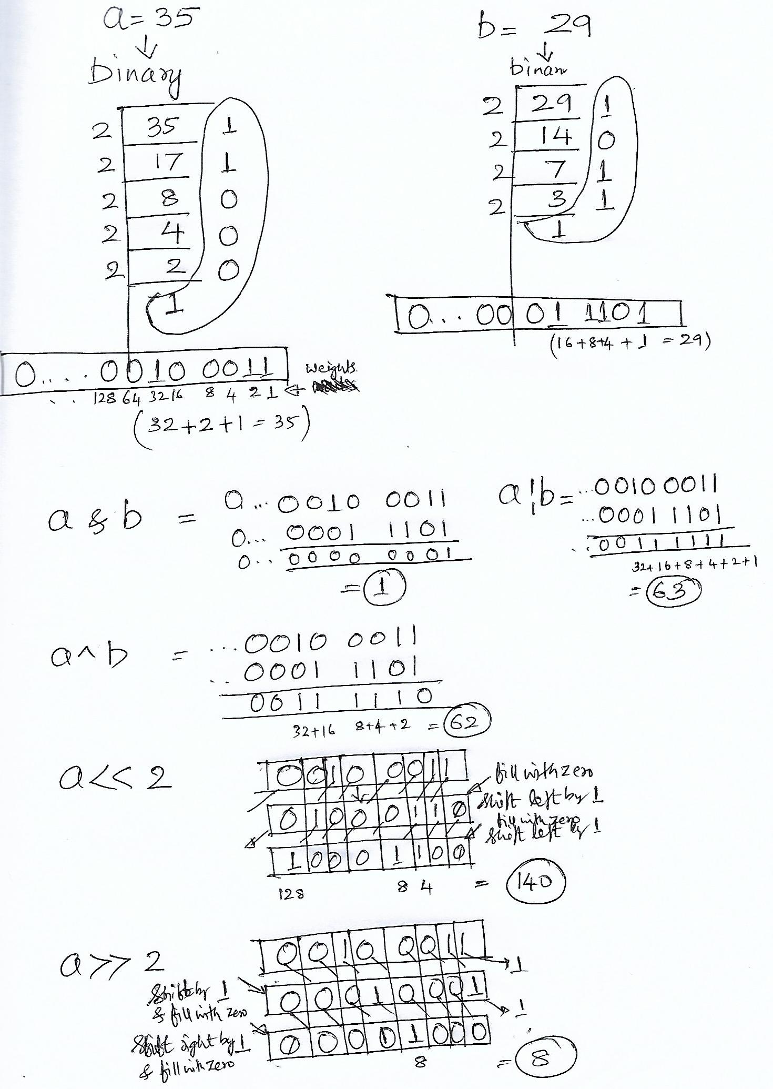
Programming in c
Bitwise Operators

Slide 20
Programming in c
Comma Operator are
- Used to link the related expressions together
They are evaluated from left to right and the value of the right most expression is
the value of the combined expression.
- Used extensively in for and while loops
Example: value = ( x=10, y = 5, x + y )
Steps:- assigns 10 to x, assigns 5 to y, calculate x + y (i.e 10+5= 15) and this is the result of the comma operator combined expression, copies to value
Special Operators
sizeof Operator
- Is a compile time operator
- It returns the number of bytes the operand occupies.
Format : sizeof( operand)
The operand may be a variable , a constant , or a data type
Ex: printf( “%d”, sizeof (int));
float val=1.5; printf(“%d”,sizeof(val));

Slide 21
Programming in c
Expression Evaluation :
Rules of Precedence & Associativity
Priority of evaluation: Operators are associated with predefined precedence Direction of evaluation: Multiple operators of same precedence are evaluated from
L to R or R to L using associativity rule of the operator
Example: Evaluate :-> x = a – b / 3 + c * 2 – 1
Take a = 9, b=12 and c = 3
Step1: substitute the values of a, b and c
9 – 12 / 3 + 3 * 2 - 1
Step2: Apply Precedence & Associativity Rules
Pass1 -> Operators * and / are of higher priority and evaluated first from L to R
Step1 9 – 12 / 3 + 3 * 2 - 1 --- > 12/3 is substituted by 4
Step2 9 - 4 + 3 * 2 - 1 -----> 3 * 2 is substituted by 6
Pass2 -> Operators + and - are of lower priority are evaluated next from L to R
Step1 9 – 4 + 6 – 1 ----> 9 – 4 is substituted by 5
Step2 5 + 6 - 1 ----> 5 + 6 is substituted by 11
Step3 11 – 1 Answer = 10
Precedence & Associativity Operators

Slide 22
Programming in c
Example: Evaluate :-> x = a – b / (3 + c) * (2 – 1)
Take a = 9, b=12 and c = 3
Step1: substitute the values of a, b and c
9 – 12 / (3 + 3 ) * (2 – 1)
Step2: Apply Precedence & Associativity Rules
Pass1 -> Parenthesis has the highest priority, multiple parenthesis are evaluated
from L to R,
Step1 -> 9 – 12 / (3 + 3) * (2-1)
Step 2 -> 9 – 12 / 6 * (2-1)
Pass2 -> / and * are evaluated next
Step1 -> 9 - 12 / 6 * 1
Step2 -> 9 – 2 * 1
Pass3 -> + and – are evaluated next
Step1 -> 9 - 2 Answer = 7
Precedence & Associativity Operators

Slide 23
Programming in c
Example: Evaluate the expression
The precedence among Arithmetic , Relational & Logical Operators :
Arithmetic Precedence
* / % ----- 1
+ - ----- 2
Relational
< <= > >= ---- 3
== != ---- 4
Logical
&& ---- 5
|| ---- 6
if (x == 10 + 15 && y < 10) ,
assume x = 20 , y =5
20 == 10 + 15 && 5 < 10
20 == 25 && 5 < 10
20 == 25 && True
False && True
False
Rules:
First, parenthesized sub expression from left to right are evaluated
If parentheses are nested, the evaluation begins with the innermost sub-expression
The precedence rule is applied in determining the order of application of operators in evaluating sub-expressions
The associativity rule is applied when two or more operators of the same precedence level appear in a sub-expression
Arithmetic expressions are evaluated from left to right using the rules of precedence
When parentheses are used, the expressions within parenthesis assume highest priority.
Precedence Operators

Slide 24
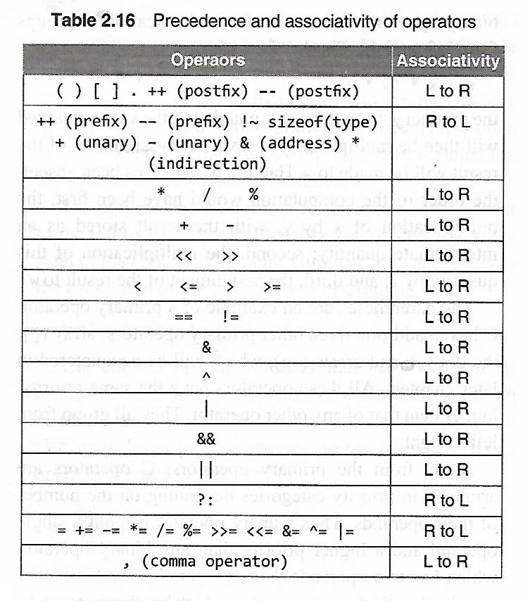
Programming in c
Precedence & Associativity of Operators
Write an expression using logical operator like AND, OR and NOT to implement XOR.
ans=(a&&!b)||(!a&&b);
Output for a=1 and b=0:
1
Precedence Operators

Slide 25
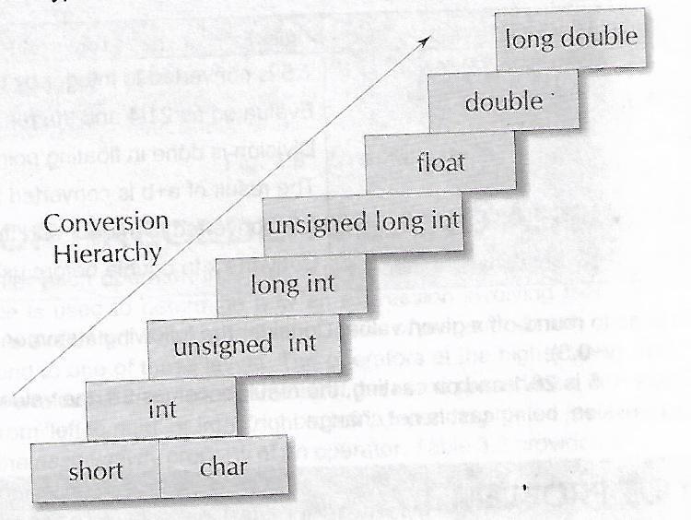
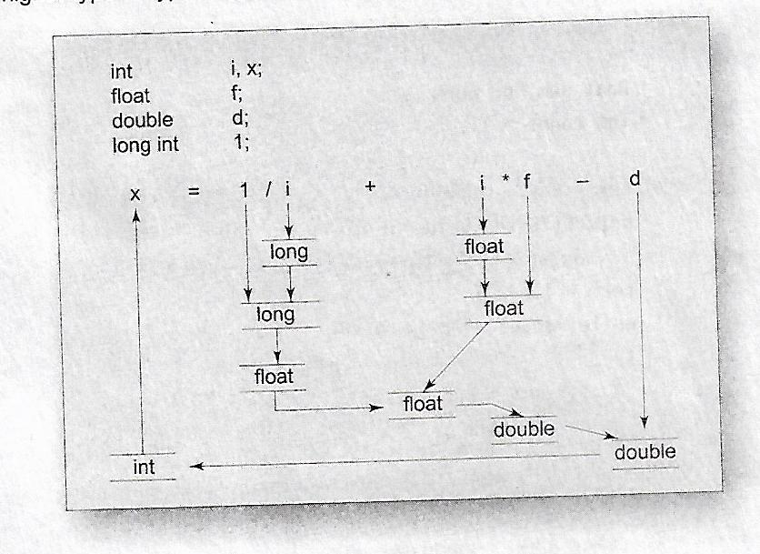
Programming in c
Implicit Type Conversion – When expression contains variables of mixed data types, c automatically converts variables to the higher size/precision types to avoid data loss and gain accuracy.
Type Conversions Operators
Explicit Type Conversion – Using the operator (data_type) user can force the data type on the variable or expression evaluation.
float percentage; int total_marks,no_subjects;
percentage = (float) total_marks/no_subjects

Slide 26
Programming in c
Implicit Type Conversion – When expression contains variables of mixed data types, c automatically converts variables to the higher size/precision types to avoid data loss and gain accuracy.
Type Conversions Operators

Slide 27
Programming in c
Quiz Questions
1. int a = 300, b= 10, c = b + 2;
if( a >= b *c*2)
b = 300;
c = 200;
printf("%d%d",b,c);
Output:
300 200
2.int x = 10,y=20;
a) if (x==y);
printf("\n%d,%d",x,y);
Output: 10,20
b) if(x=y)
printf("\n%d,%d",x,y);
Output: 10,20
c) if(x==y)
printf("\n%d,%d",x,y);
Output: no o/p
3.int x=3,y=5%2;
if(x==3)
printf("\n%d",x);
else;
printf("\n%d",y);
Output: 3
1
4. int x=3/2;float a = 1.5;
if(x==a)
printf("equal");
else
printf("not-equal");
Output:
not-equal
5. k = 40;
printf("%d,%d,%d",k==40,k=4,k>=4<<1);
Output:1,4,0
6. float val=0.33;
if(val==1/3.0)
printf("Success\n");
Output:
no output
7. printf("%d",'0');
printf("%c",'0');
Output:
48
0
8. printf("\x30 \n");
Output:
0
9. int a ='A';
a='A'+1;
printf("%c",a);
Output:
B
Quiz Questions

